Slide 1
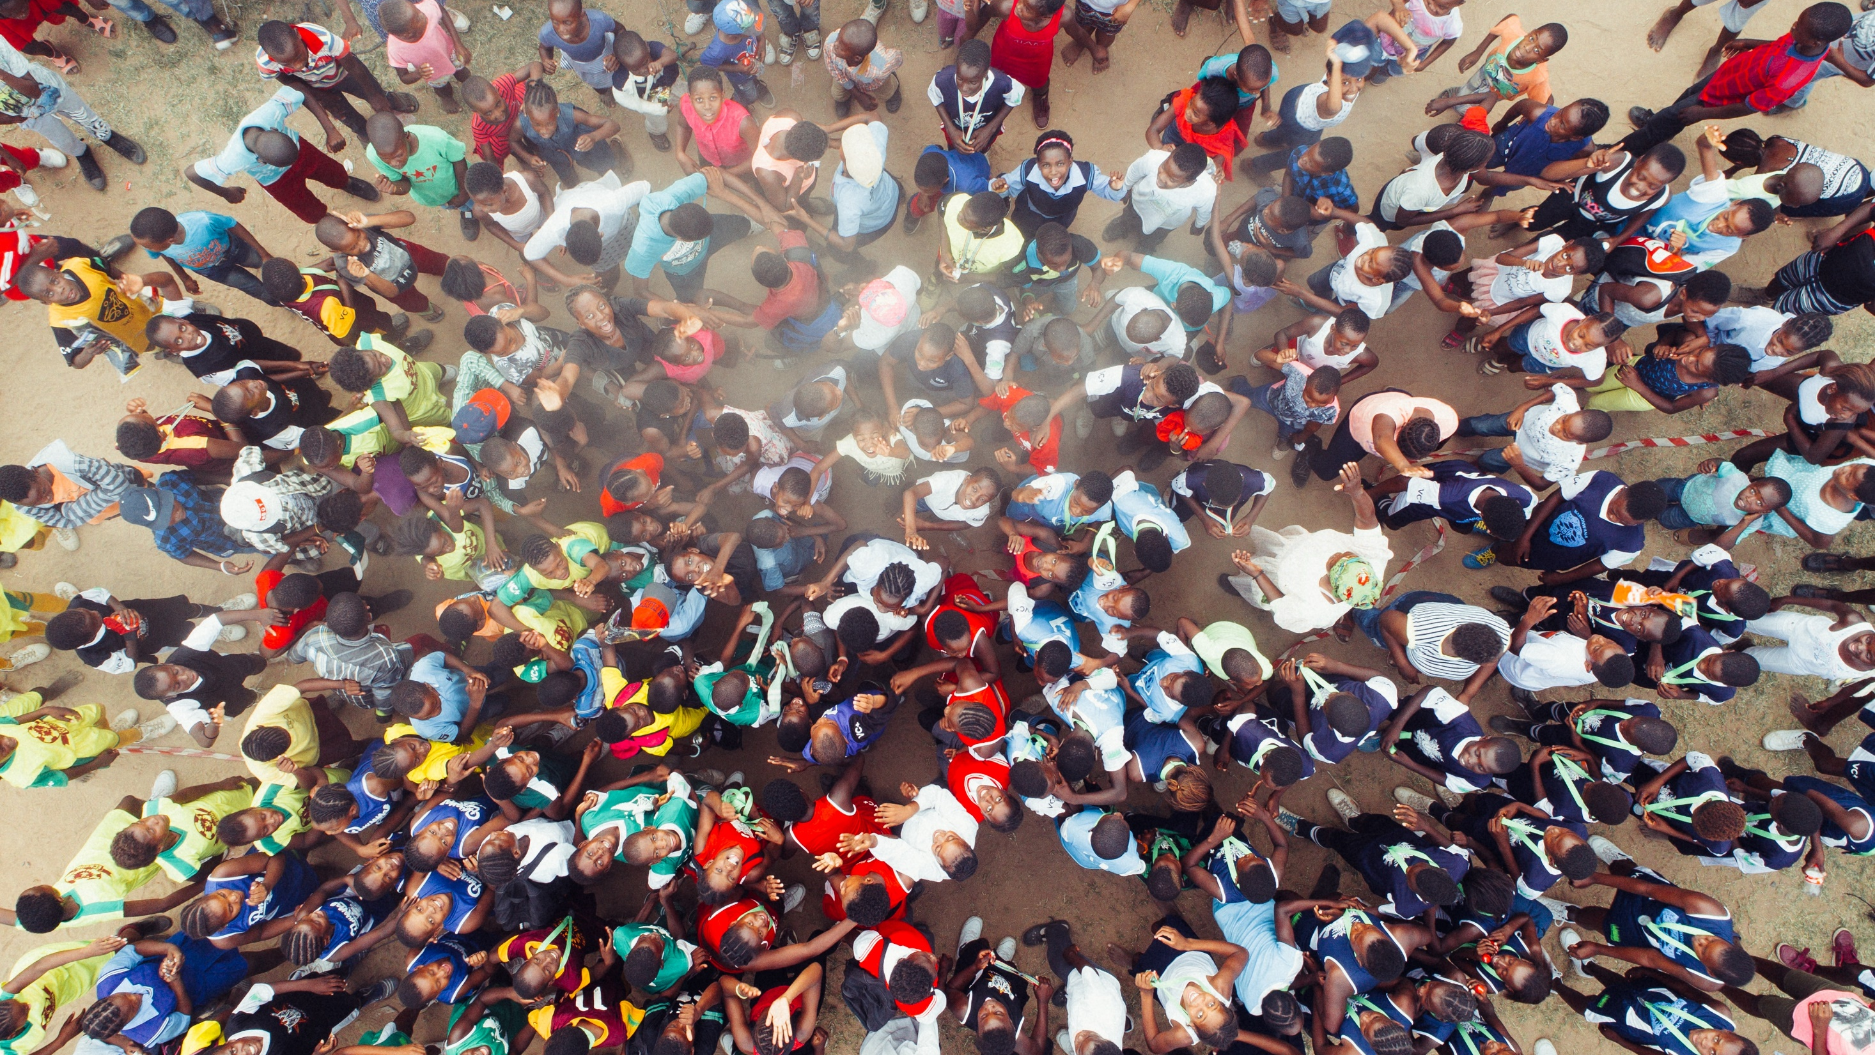

World Bank Training Workshop:
Introduction to Call Detail Records Analysis
18th July 2019
Tracey Li
tracey.li@flowminder.org

Slide 2
Outline
Introduction to Flowminder
Introduction to Call Detail Records (CDRs)
Data quality considerations
Example methods and applications
Obtaining access to CDR data
Hands-on analysis exercises with simulated data

Slide 3
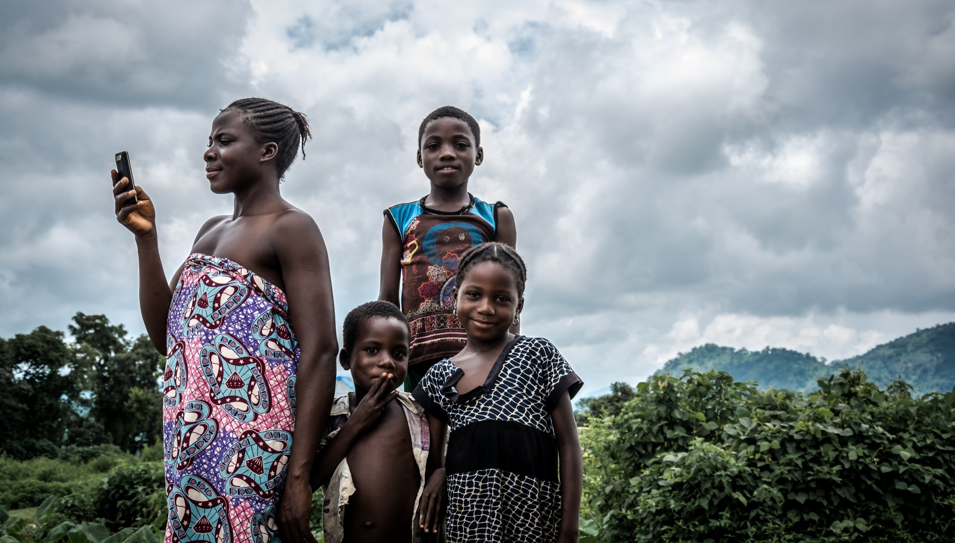

Introduction to
Flowminder

Slide 4
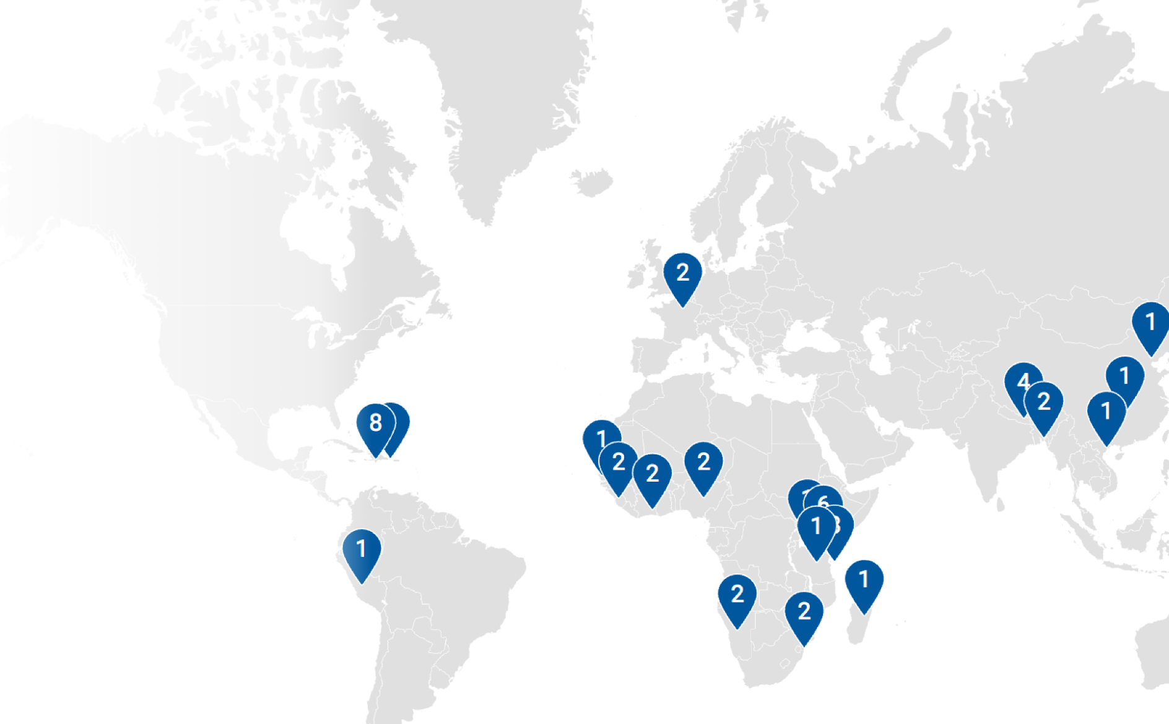
About Flowminder
Flowminder is a non-profit foundation whose work focuses on vulnerable populations in LMICs.
We specialise in the analysis of mobile operator data for development and humanitarian applications.
We also work with geospatial and survey data.

Slide 5




















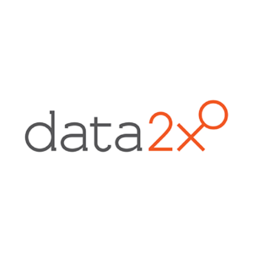


Donors & Partners
Academic partners
Donors and collaborators

Slide 6




Key Partners: Mobile Network Operators (MNOs)
We invest a lot of time and effort developing trusted, sustainable relationships with MNOs in order to obtain access to their data.

Slide 7

Introduction to Call Detail Records

Slide 8
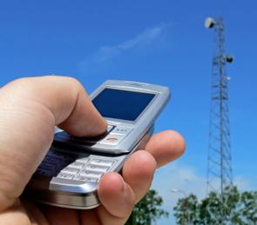
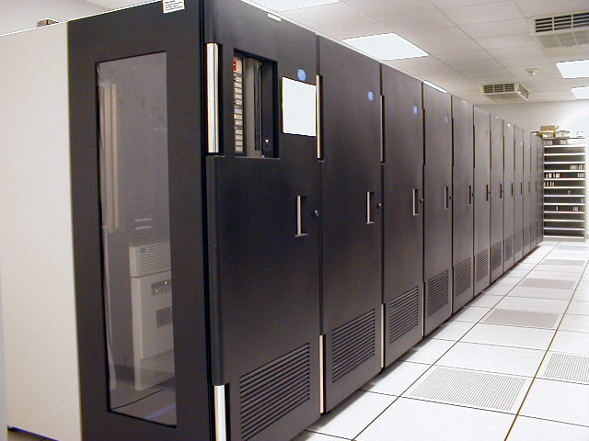

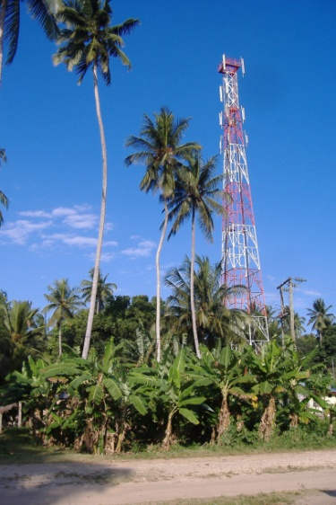
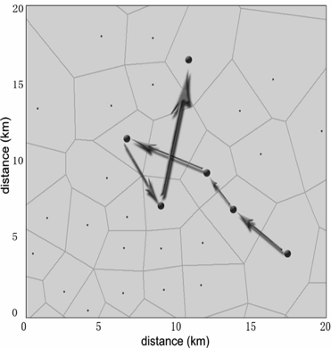

What is CDR data?
Call detail records are generated automatically by MNOs for operational purposes (billing).
X
User makes a call from location X
Network operator
records time and
tower of call for billing
Call routed through nearest tower
Y
User travels to location Y and makes a call

Slide 9
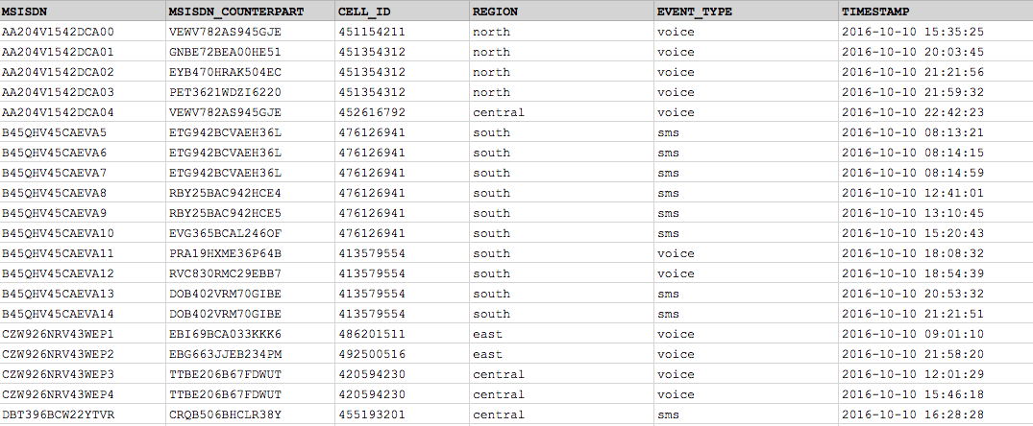

What is CDR data?
anonymised caller ID
anonymised receiver ID
date and time of call
ID of network cell – maps to location

Slide 10
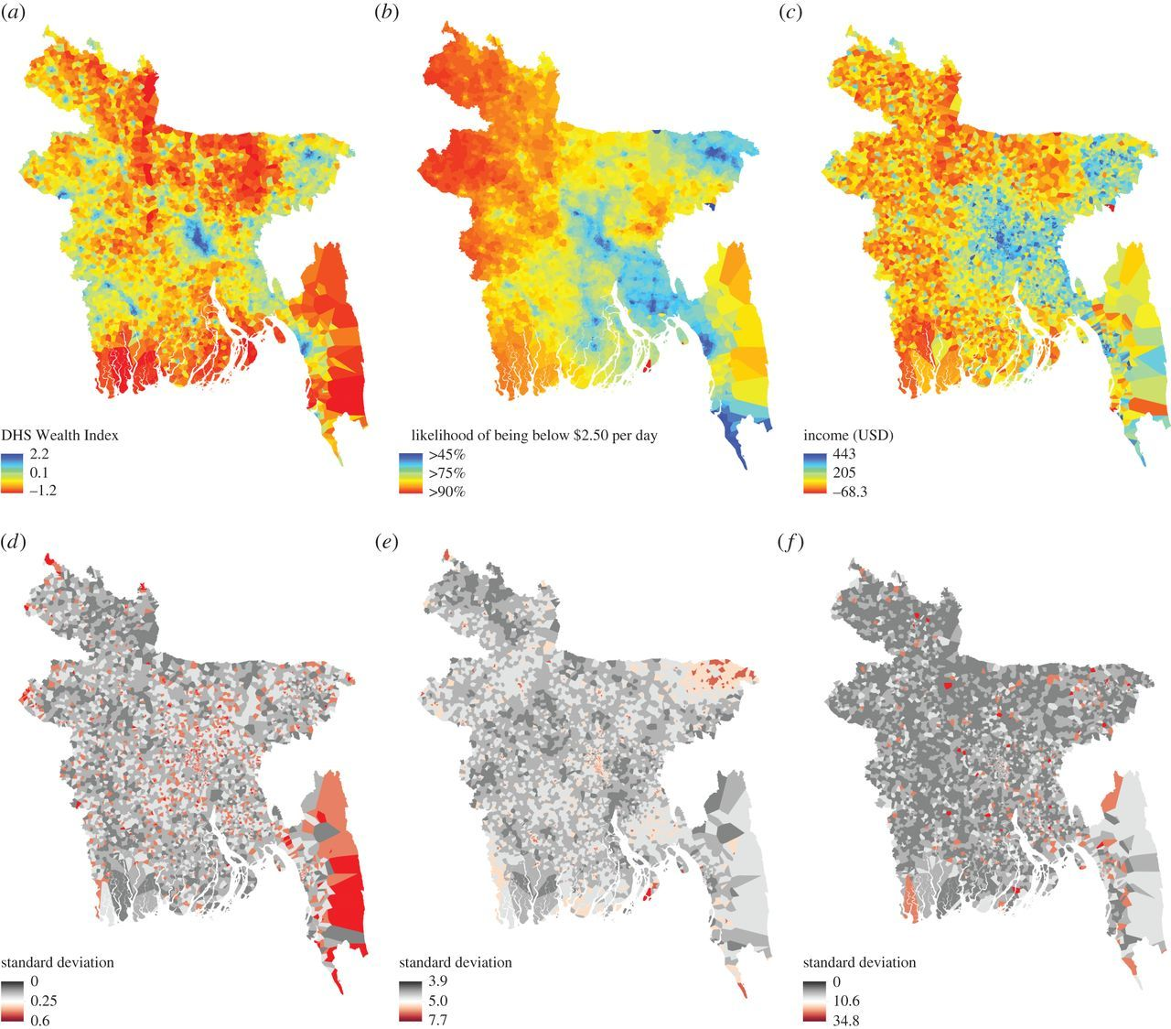
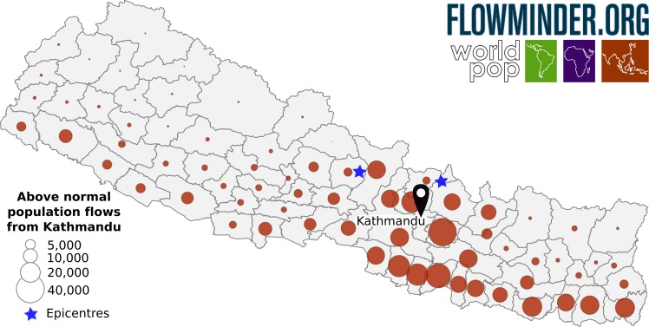
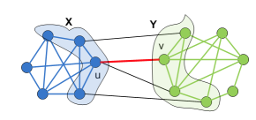


What can you do with CDR data?
Social network analysis – study connections between populations
Profiling e.g. inferring poverty status from calling behaviour
Location and mobility analysis of populations
R. Wilson et al. (2016). Rapid and near real-time assessments of population displacement using mobile phone data following disasters: the 2015 Nepal earthquake. PLoS Currents.
D. P. Nguyen et al. (2011). Adaptive algorithms for detecting community structure in dynamic social networks. Proceedings IEEE INFOCOM.
J. E. Steele et al. (2016). Mapping poverty using mobile phone and satellite data. Journal of the Royal Society Interface.

Slide 11



How is CDR analysis relevant in LMICs?
Accurate data on population movements are necessary inputs to relief / eradication / intervention programs in LMICs to address the following:
Natural disasters
Conflicts
Infectious diseases

Slide 12



How is CDR analysis relevant in HICs?
Accurate data on population distributions and movements is often available in HICs.
However, performing manual population counts at high temporal resolution is impractical. There is value in inferring dynamic population counts from CDR data e.g.
Intra-census regional population estimates
Seasonal migration and travel patterns
Real-time commuting patterns

Slide 13
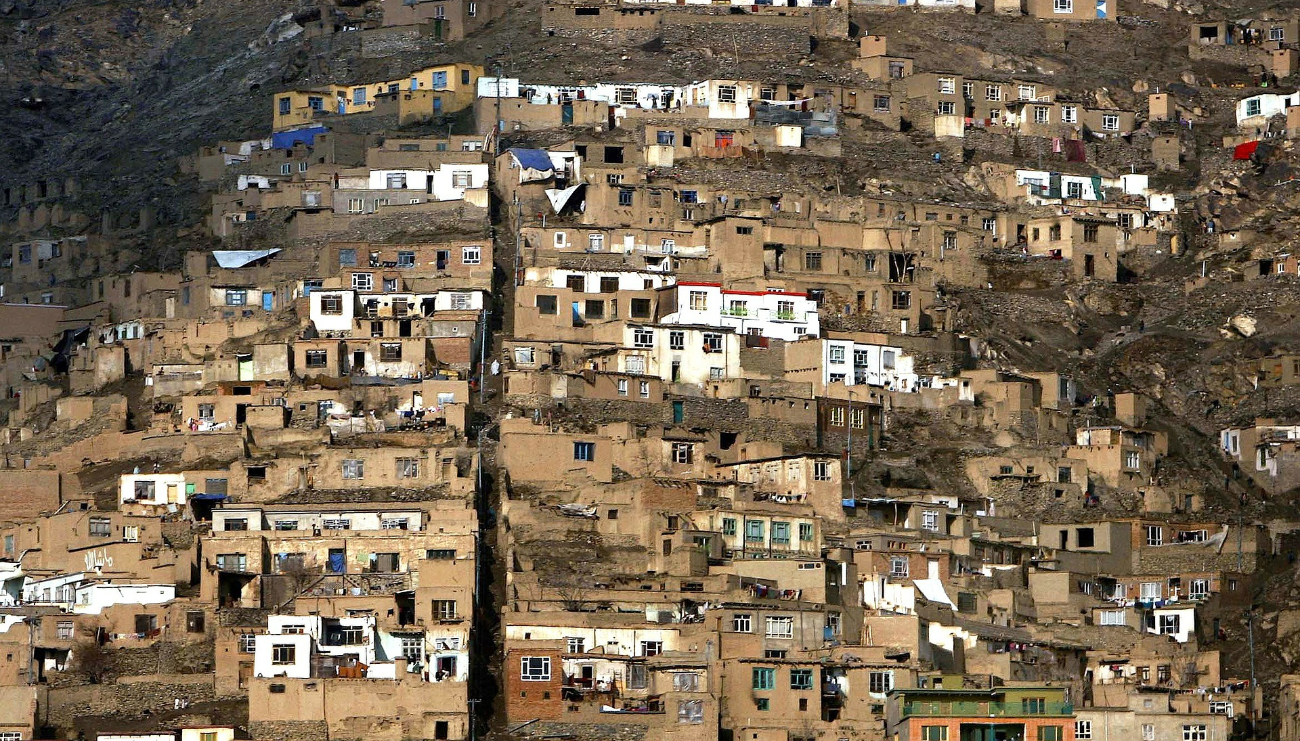
Data quality

Slide 14
Data quality – system or processing issues
The following issues are commonly seen in a raw CDR dataset:
Data missing for some time period
Corrupted records
Bugs in location e.g. location is outside country borders
These are typically due to operational or processing issues at the MNO.
Quality Assurance checks, prior to analysis, are very important!

Slide 15
Data quality – Analysis issues
The following are some of the inherent limitations of a CDR dataset that need to be taken into consideration during analysis:
Spatial resolution (density of cell towers) – how accurately can we determine someone’s location? Is this important?
Temporal resolution – how frequently do people use their phones?
Inclusion of SIMs that belong to call centres or businesses, not individuals.
The dataset only includes people that use a SIM from a particular mobile operator.
How many people use each SIM?

Slide 16
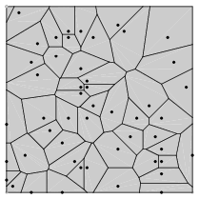
Spatial resolution
The density of cell towers affects the uncertainty of the location estimate if the location of the cell tower is the only available information (often the case).

Slide 17
Temporal resolution
A lot of people use their phones infrequently (e.g. less than once a week) in LMICs.
Imagine you want to know whether someone has been displaced from their home.
Here are the locations that you see people at each day:
Person 1: → → → →. → → → → What conclusions
do you draw about
Person 2: → → → → → → → each individual?
Person 3: → → → → → → →
A
A
A
A
A
A
B
B
A
?
?
?
A
?
?
B
A
?
?
?
?
?
?
B

Slide 18
Sampling bias
Typically, we only have access to data from a single MNO.
Are the people in the dataset representative of the entire population that we want to make inferences about?
If not, what is the demographic and geographic distribution of individuals included in the dataset?

Slide 19
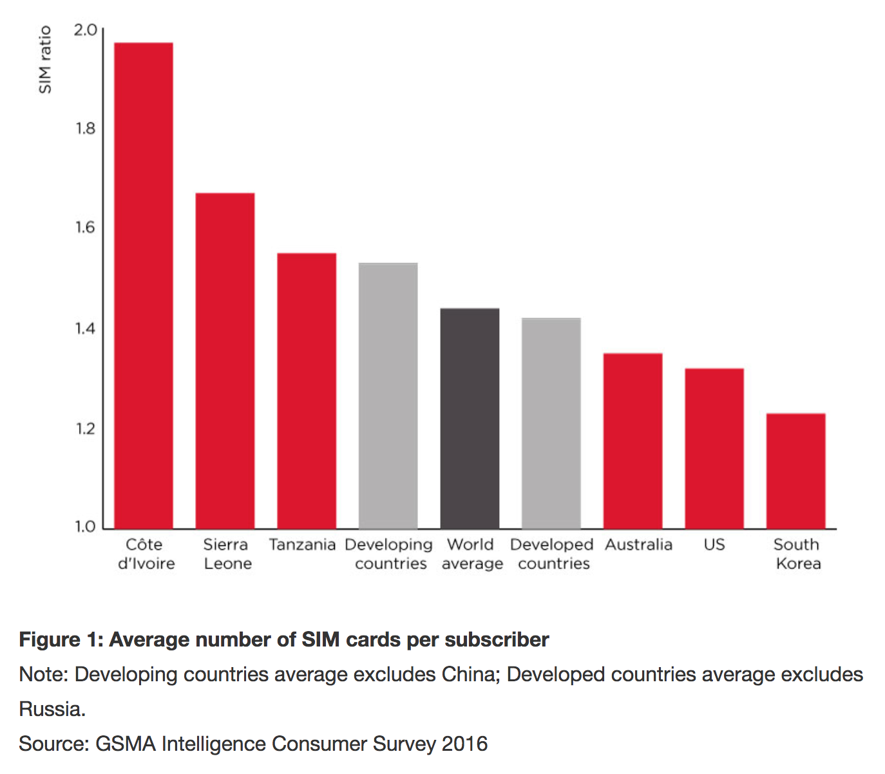
SIMs per person
It is more common for people in LMICs to use multiple SIMs.
“The GSMA Intelligence Consumer Survey 2016 shows that variable network quality is the second biggest driver of multi-SIM ownership.”
https://www.gsmaintelligence.com/research/2017/01/variable-network-quality-a-key-driver-of-multi-sim-ownership/597/

Slide 20
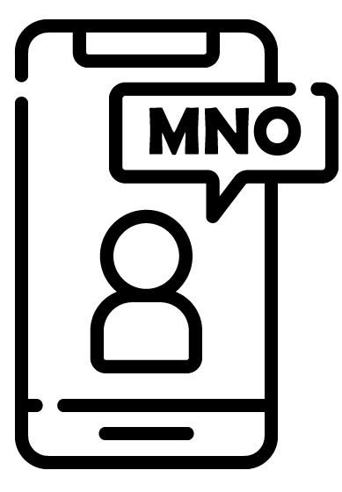

SIMs per person
We know also from ICT surveys that family members and friends often share a SIM.
Therefore, assuming that “1 SIM = 1 person” isn’t always valid.

Slide 21
SIMs per person
We know that many family members often share a phone. Why is this important?
If we have a sequence of locations:
→. → → → → → → → →
Did 1 person visit all 4 locations [A B C D]?
Or did person 1 visit [A B C] and another visit [A B D]?
This is important to know when studying e.g. infectious disease spread.
A
B
C
A
A
A
B
A
D

Slide 22
Examples of analysis considerations
Which subscribers should we include in the analysis - what calling frequency is required in order for us to achieve the desired level of confidence in the analysis?
Are the subscribers that we include in the analysis representative of the ones that we are leaving out?
What level of uncertainty in location can we tolerate?
What are the consequences of over-estimating (population counts) vs under-estimating?
... Add your own here!

Slide 23
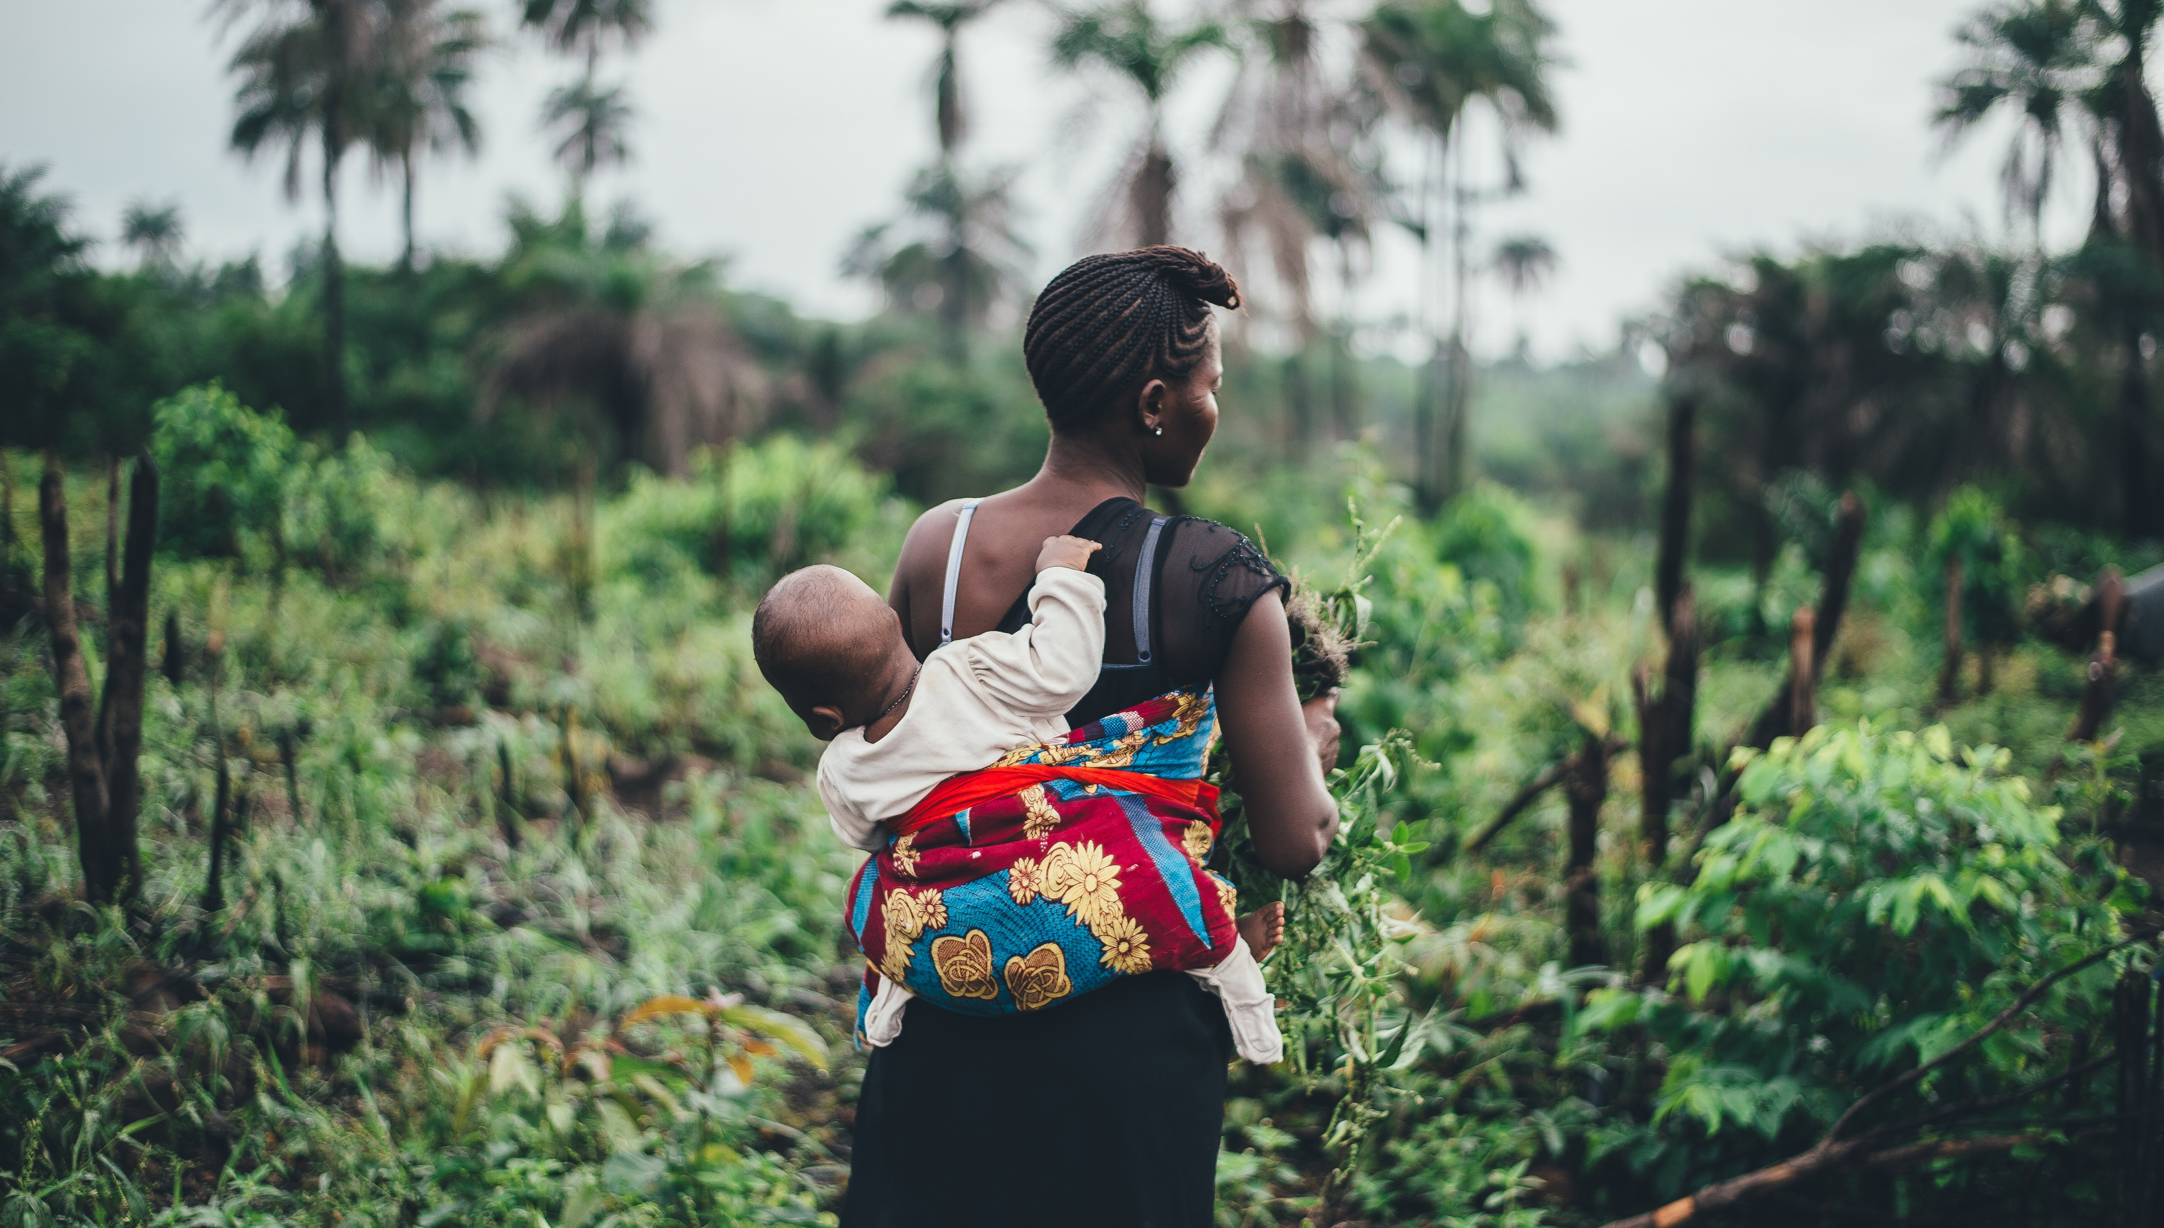
Example methods and applications

Slide 24
Post-disaster response: introduction and method
After the 2015 earthquake in Nepal, the Flowminder/WorldPop teams used anonymised CDR data to quantify the impact on population movements.
Divide time period into 3 periods:
‘benchmark’ (pre-disaster)
‘comparison’ (just before disaster)
‘focal’ (after disaster)
Then count movements into and out of each region (‘flows’) during each period.

Slide 25
Post-disaster response: analysis
Compare flows after the disaster with normal flows before the disaster.
This shows how the disaster impacted people’s mobility behaviour.
R. Wilson et al. (2016). Rapid and near real-time assessments of population displacement using mobile phone data following disasters: the 2015 Nepal earthquake. PLoS Currents.

Slide 26
Predicting post-disaster movements: introduction
We developed new methods in order to do the following:
Identify the subset of individuals who became internally-displaced persons (IDPs) as the result of a natural disaster.
Identify the location and duration of displacements.
Create models to describe and predict patterns of displacement.

Slide 27
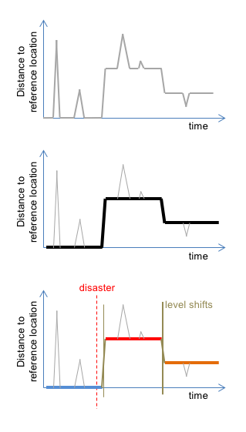
Predicting post-disaster movements: method
Our new method is based on decomposing each person’s trajectory into a sequence of ‘stay locations’, separated by ‘steps’.
The method has several components: spatial clustering, median filtering, imputation, step detection.
The processed trajectory is a model - a simplified approximation of the original trajectory. It is easy and fast to analyse.
T. Li, J. Dejby, M. Albert, and V. Lefebvre (2019). Flowminder.

Slide 28
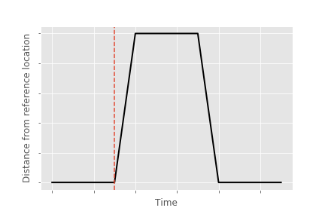
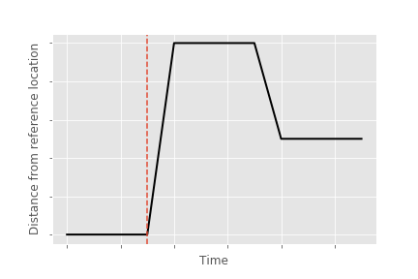
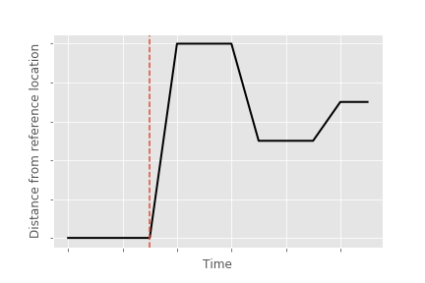
Predicting post-disaster movements: method
We used the modelled trajectories to identify the following groups:
IDPs that return home
IDPs that resettle somewhere
IDPs that remain displaced
We then analysed the social networks of the IDPs.
T. Li, J. Dejby, M. Albert, and V. Lefebvre (2019). Flowminder.

Slide 29
Predicting post-disaster movements: key findings
We studied 3 disasters and found that:
Most displacements occur a short distance (< 10 km) from the IDP’s home
IDPs who have most of their contacts or familiar places around their home locations tended to be displaced closer to their home, regardless of disaster intensity
60-70% of long-distance displacements (> 100 km) were made to join a contact or familiar place, and were generally far away from displacement sites.
J. Dejby, T. Li, M. Albert, and V. Lefebvre (2019). Flowminder.

Slide 30
Estimating internal migration: introduction
The use of CDR data to produce official statistics is being explored by many National Statistics Offices (NSOs). Advantages are:
It may be cheaper than doing manual surveys.
It takes less time to produce the statistics.
Statistics can be produced more frequently than with surveys (possibly in real-time).
Which statistics can be accurately calculated using CDR data?

Slide 31
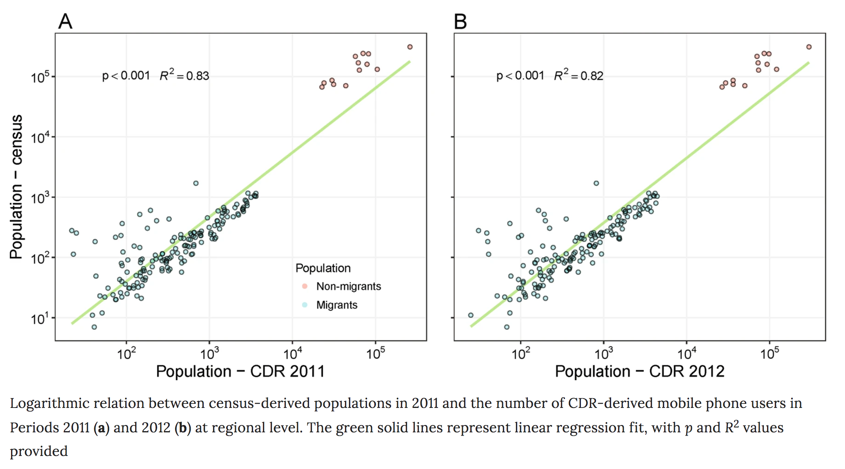
Estimating internal migration: results
A comparison of migration flows in Namibia, calculated from CDR data, with census data from the same period (2011), shows good consistency.
S. Lai et al. (2019). Exploring the use of mobile phone data for national migration statistics. Nature Palgrave Communications.

Slide 32
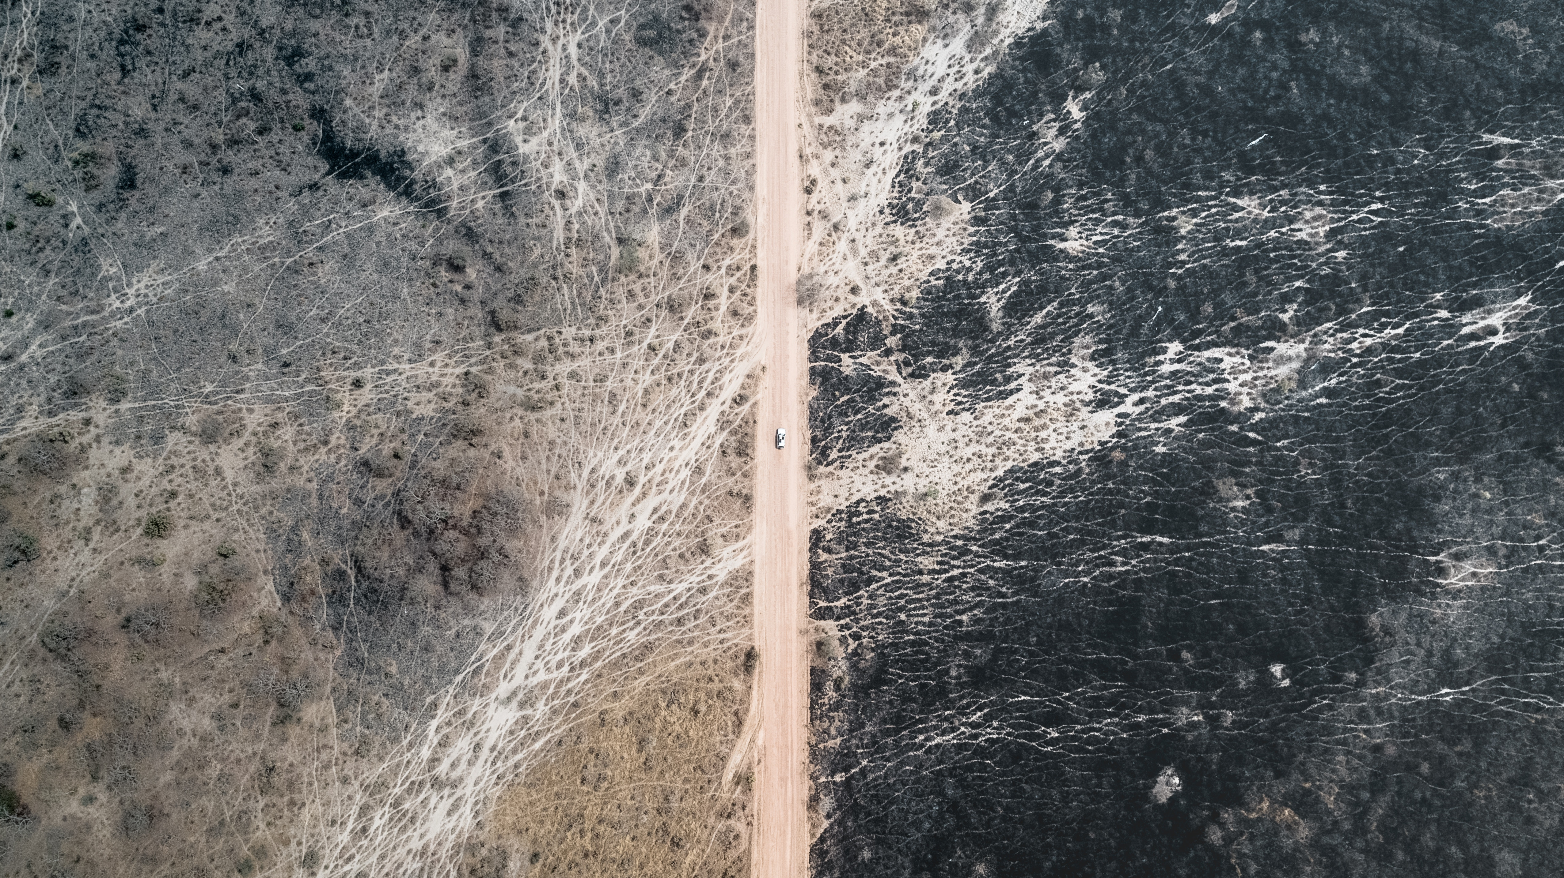
Obtaining access to CDR data

Slide 33
Obtaining data access is hard
It can be very challenging to obtain access to CDR data, for the following reasons:
Privacy and legal concerns
Ethical concerns
Low incentives for mobile operators to share their data.

Slide 34
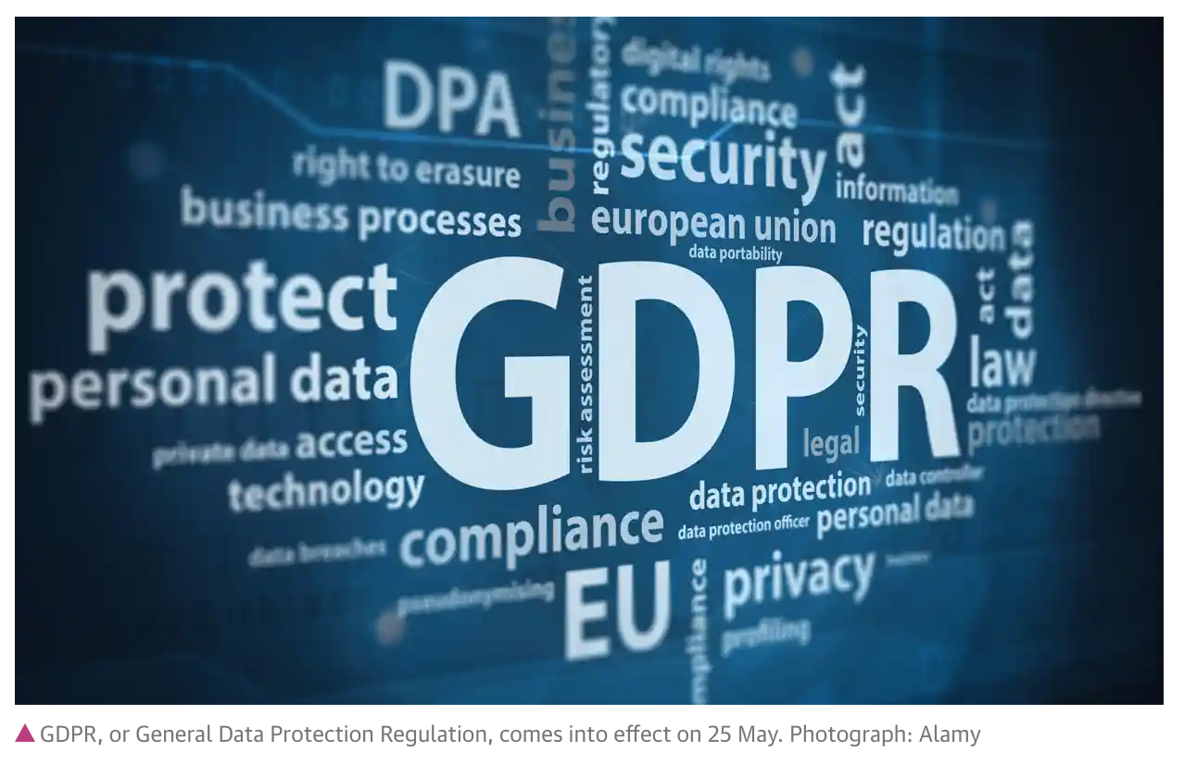
Privacy & Legal
CDR data are ‘personal data’ because it contains the location history of each person.
Personal data are subject to strict national and regional legislations.
The Guardian, 12th May 2018
These laws specify how personal data need to be treated. They protect the privacy rights of citizens.

Slide 35



Privacy & Legal
Compliance with all relevant legislations is necessary in order to obtain data access. This may include interacting with the national regulatory body.
The MNO may also have their own internal requirements that need to be met.

Slide 36
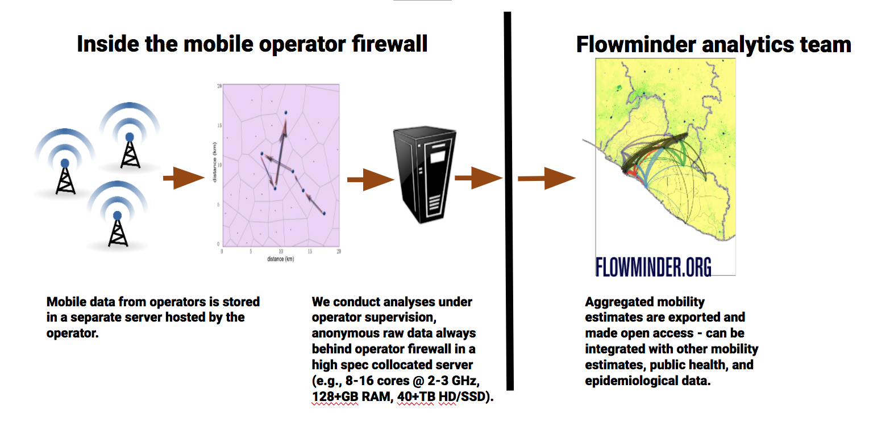
Privacy & Legal
We ensure that our work is compliant with all required legislations, including GDPR.
We choose also to adhere to GSMA data integrity guidelines, so data never leaves the MNO premises.

Slide 37
Ethical concerns
What happens if the data, or the insights, fall into the hands of undesirable actors?
How do we prevent the misuse of data? Whose responsibility is this?
How do the risks compare to the benefits, and the risks of non-use?

Slide 38
Why should MNOs share their data?
Mobile operators must invest time and resources to provide data access.
There are also risks associated with sharing this data:
A data breach would have a very negative impact on their reputation
Miscommunication about the project will have a very negative impact
The data have high commercial value to them, and competitors can take advantage.
Given the risks, why do you think some MNOs are willing to share their data?
CSR is one reason – see e.g. https://ghanaweb.com/GhanaHomePage/business/Vodafone-Foundation-crowned-CSR-leader-in-Ghana-760720

Slide 39
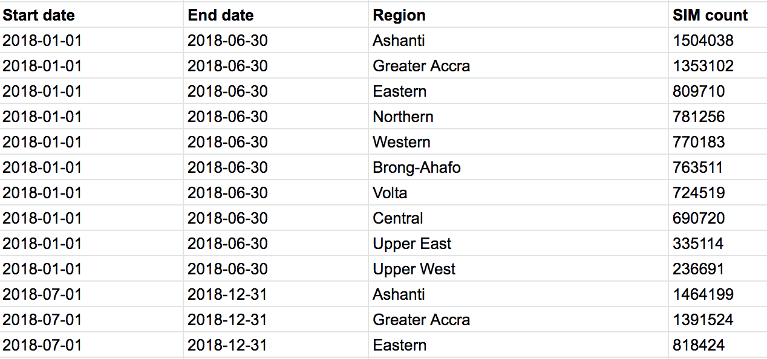
Accessing individual-level vs aggregated data
You can either have access to individual-level data, or aggregated data.
Individual-level data are the records of each individual person.
Aggregated data only contains the number of people in each region, or making a particular journey.

Slide 40
Individual-level data or aggregated data
Individual-level data is personal data.
It is subject to data protection laws.
Extensive IT infrastructure and IT security is required to securely process the data.
Aggregated data is not subject to as many restrictions.
The mobile operator, or a third party, will aggregate the data and then pass to the analyst.
Storage and processing is much simpler.

Slide 41
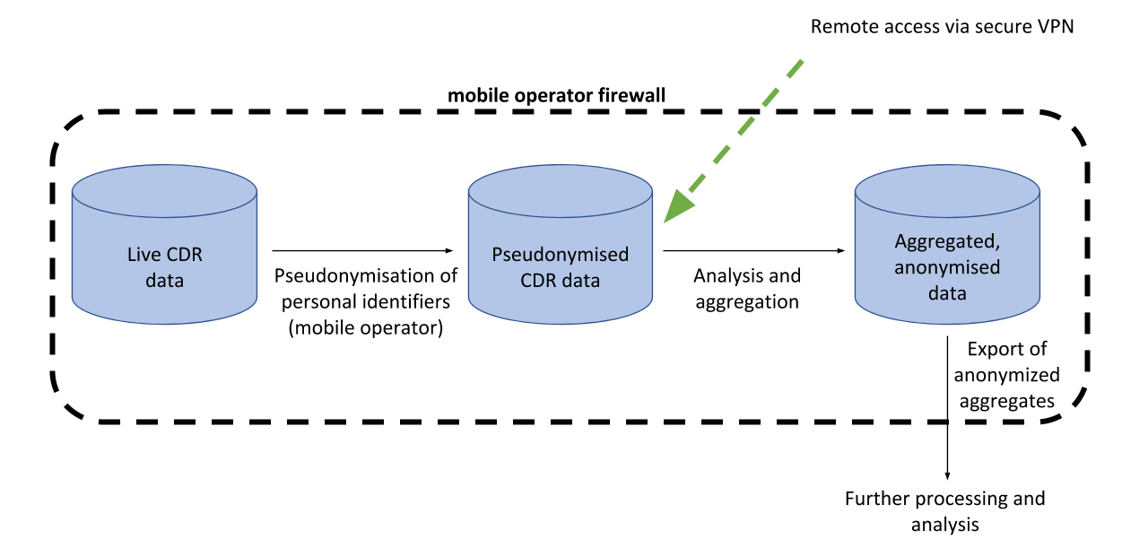
Accessing individual-level data – remote access
If you want access to individual-level data, one of the best models is remote access.
Individual-level data never leave the mobile operator premises. All storage and processing is done on-site.

Slide 42
Accessing aggregated data (1)
The mobile operator can compute aggregates and give these to you.
You only get the aggregates that the operator has computed, and have little control over what methods are used.
Alternatively, a third-party (e.g. Flowminder) can perform the aggregation, according to custom-designed methods.

Slide 43
FlowKit information
Another option is for the mobile operator to install third-party software that provides an interface between their data and you e.g. FlowKit https://github.com/Flowminder/FlowKit
You can have more freedom over which aggregates are produced and how, even though you never see the individual-level data.
The operator retains full control over who can access what data.

Slide 44
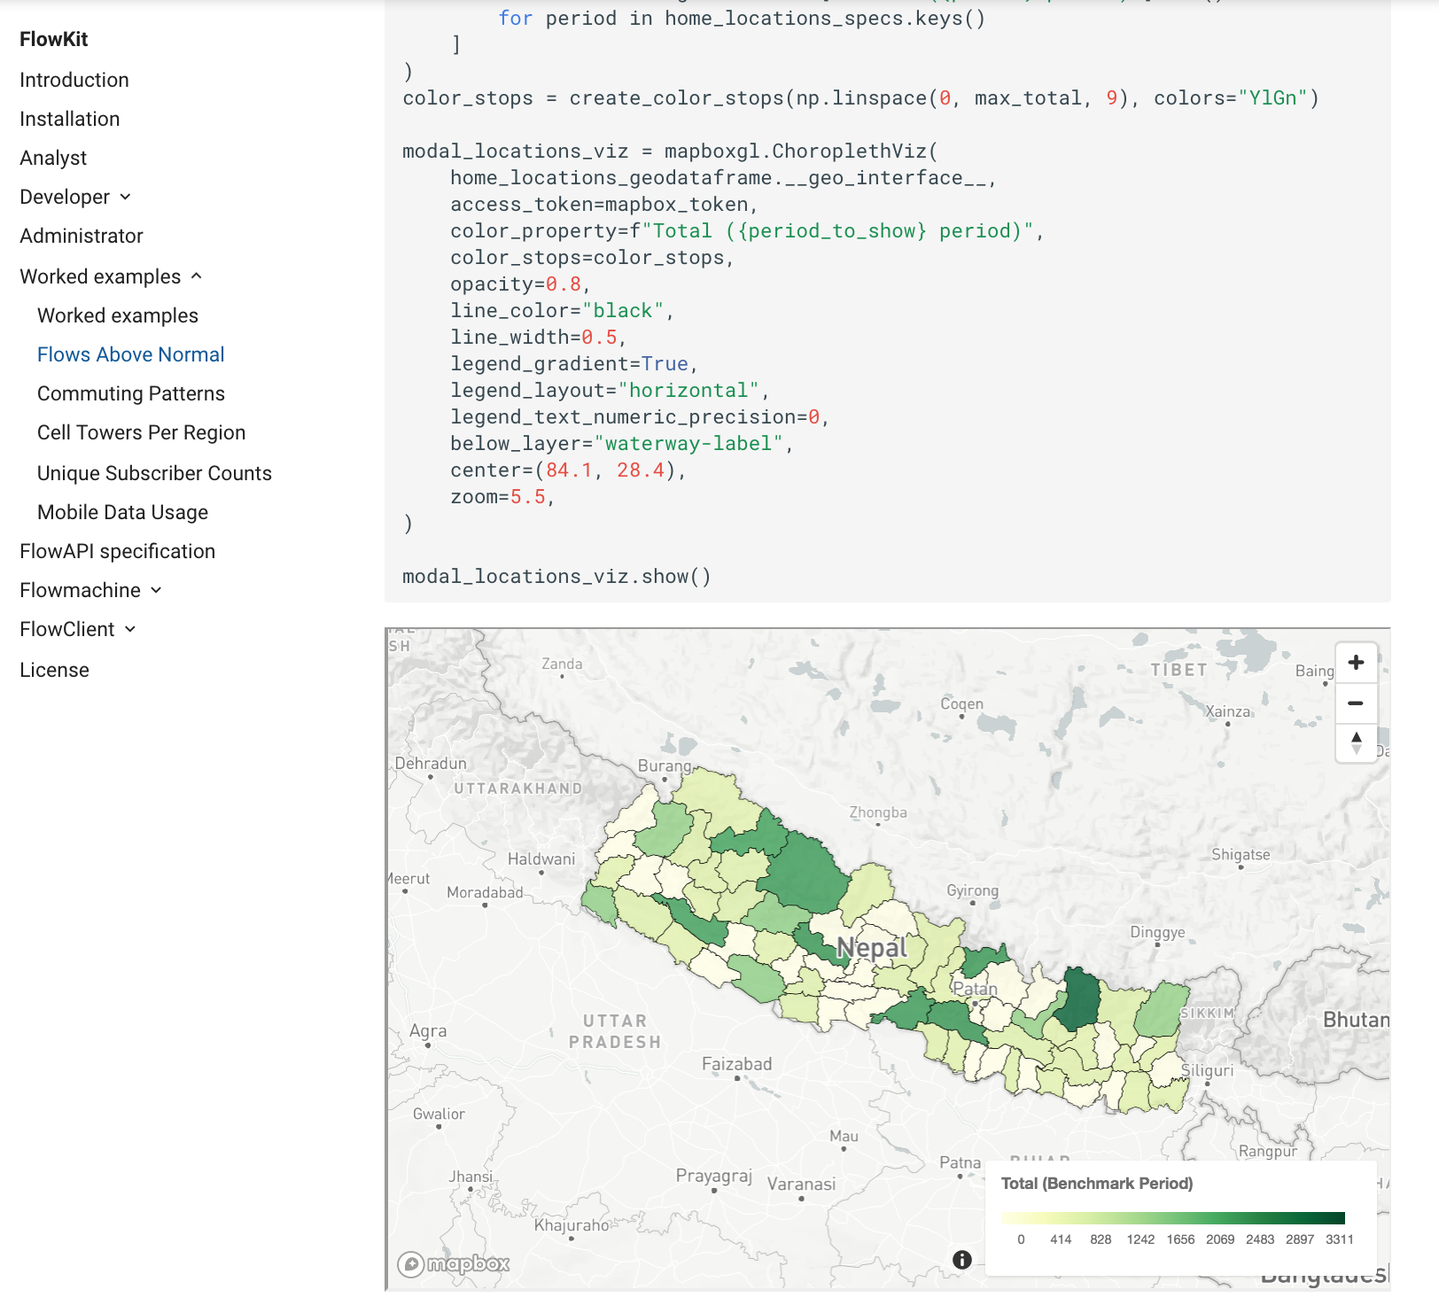
Accessing aggregated data (2)
Example analyses using FlowKit can be found here:
https://flowkit.xyz/worked_examples/
The FlowKit white paper is available here:
https://digitalimpactalliance.org/wp-content/uploads/2019/02/FlowKit_UnlockingthePowerofMobileData.pdf
Email the team for more info: flowkit@flowminder.org

Slide 45
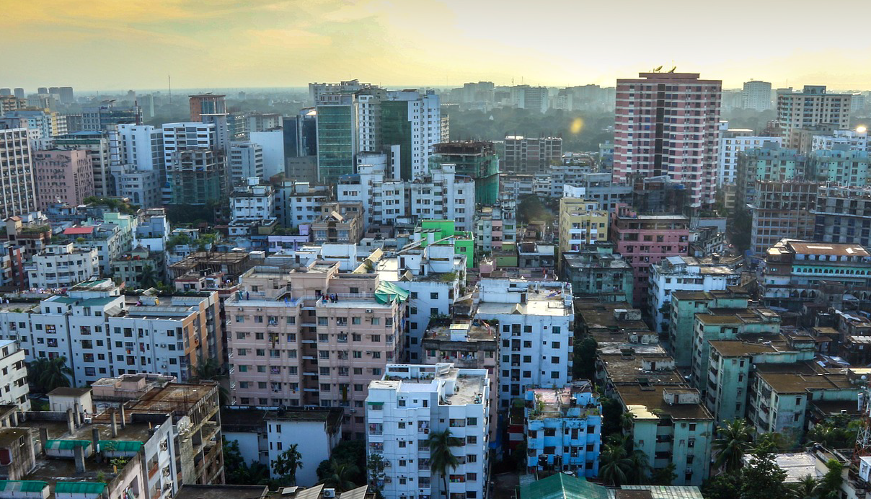
Hands-on exercises

Slide 46
Explore (fake) CDR data
The provided datasets (‘cdr.csv’, ‘locations.csv’) contain fake data from a fictional island. You will explore these data using the Python skills you have learnt in the workshop. (Or you can use Excel, or any other tool of your choice).
Notes:
These exercises are for training purposes only. In real analyses, information at this individual subscriber level should never be released.
Please do not share these datasets with anyone. We are still working on these and will shortly have something that is public and shareable.

Slide 47
Dataset description – cdr.csv
Column name | Description
subscriber_id | Anonymised ID of the subscriber.
date | Date of the call.
time | Start time of the call.
location_id | ID of the cell tower the call was routed through.
outgoing | True if subscriber made the call, False if received.

Slide 48
Dataset description – locations.csv
Column name | Description
location_id | ID of the cell tower
lon | Longitude
lat | Latitude
admin1 | Administrative level 1 region
admin2 | Administrative level 2 region
admin3 | Administrative level 3 region

Slide 49
Questions
How many subscribers are in this dataset?
What time period does the dataset cover?
How many distinct cell towers has each subscriber been seen at?
How many distinct admin 3/2/1 regions has each subscriber visited?
What is the maximum number of cell towers that anyone has visited in a single day?
What is the maximum number of admin 3/2/1 regions that anyone has visited in a single day?
On how many days is each subscriber active?
How many events are there per day, on average, for each subscriber, only counting days with events?
During which hour(s) of the day is there most activity? When is there least activity?
Estimate the home admin3 region of each subscriber. (Choose or come up with your own method).

Slide 50
Open analysis questions
How are the subscribers similar and different, in terms of their mobility behaviour?
How are the subscribers similar and different, in terms of their calling behaviour?
What types of information contained in this dataset could be indicative of socioeconomic status / poverty level?

